Slide 1
Encoding – disposal – garbage collection
Continuous staff improvement project
Rami Atieyeh

Slide 2
Introduction
Encoding
Strings
Time, Date, offsets and time zones
Format providers – culture
Disposal and garbage collection
finalizers

Slide 3
Text Encodings - unicode
A character set is an allocation of characters, each with a numeric code or code point.
There are two character sets in common use: Unicode and ASCII.
Unicode has an address space of approximately one million characters, of which about 100,000 are currently allocated.
Unicode covers most spoken world languages, as well as some historical languages and special symbols.

Slide 4
Text Encodings - ascii
ASCII set is simply the first 128 characters of the Unicode set, which covers most of what you see on a U.S style keyboard.
Still sometimes used for its simplicity and efficiency - each character is represented by one byte

Slide 5
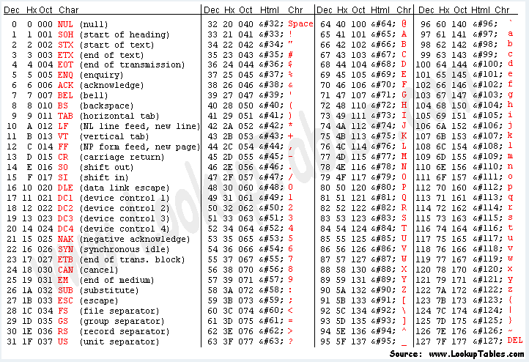
Text Encodings - ascii
ASCII table

Slide 6
Text Encodings
A text encoding maps characters from their numeric code point to a binary representation.
In .NET – dealing with text files or streams – a text encoder translates the file data from binary into the internal Unicode representation that the char and string types expect.
A text encoding can restrict what characters can be represented, as well as impacting storage efficiency.
There are two categories of text encoding in .NET:
Map Unicode characters to another character set
Use standard Unicode encoding schemes

Slide 7
Text Encodings
First category – contains legacy encodings
EBCDIC - IBM’s encoding
ASCII
GB18030 – Standard for Chinese applications
Second category – newer encodings
UTF-8 – most space efficient, uses between 1 and 4 bytes to represent each character, most popular
UTF-16 – used by .NET internally to represent characters and strings, between 2 and 4 bytes to represent each character
UTF-32 – every character consumes 4 bytes

Slide 8
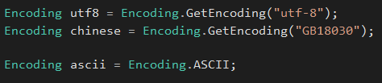
System.Text.Encoding class
Encoding class is the base type for classes that encapsulate text encodings.
Instantiate
The most common encodings can also be obtained through dedicated static properties on Encoding class.

Slide 9
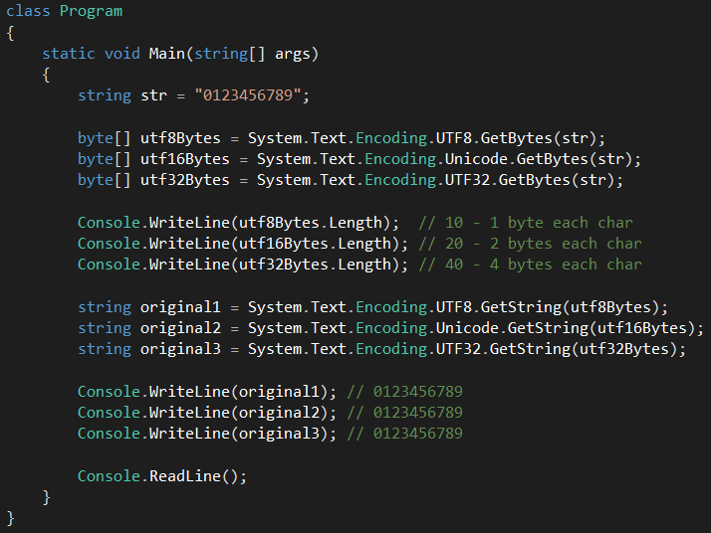
System.Text.Encoding class
GetBytes() method converts from string to byte[] with the given encoding.
GetString() method converts from byte[] to string with the given encoding.

Slide 10
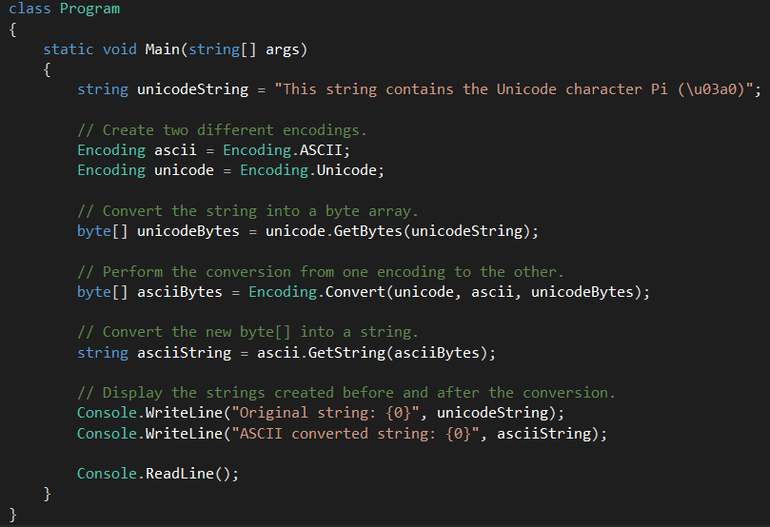
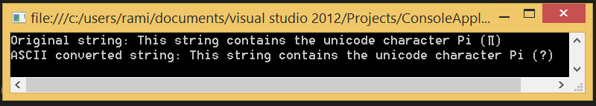
Text Encodings - Example
Encoding.Convert() - Converts an entire byte array from one encoding to another.

Slide 11



Strings – constructing
Simplest way – assigning a literal
Create a repeating sequence of characters
Construct from char array – the method ToCharArray does the reverse

Slide 12
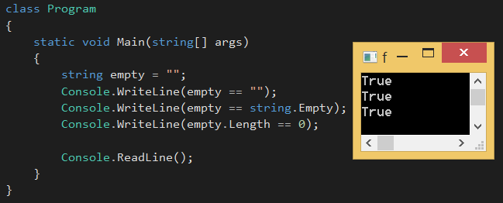
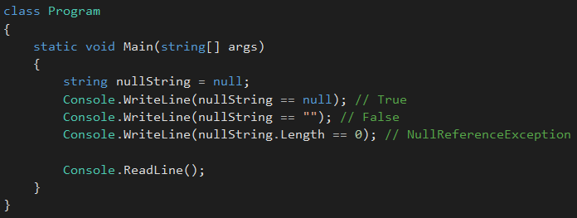
Strings – Empty strings
An empty string has a length of zero.
Strings are reference types – they can be null.

Slide 13
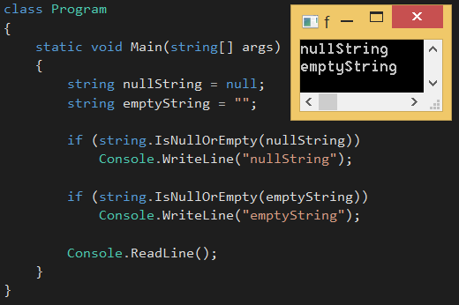

Strings – Empty strings
Method string.IsNullOrEmpty can be used to check
A string’s indexer returns a single character at the given index.

Slide 14
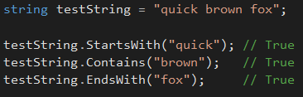
Strings – searching
Simplest way is to use one of the methods – Contains – StartsWith – EndsWith
Example

Slide 15
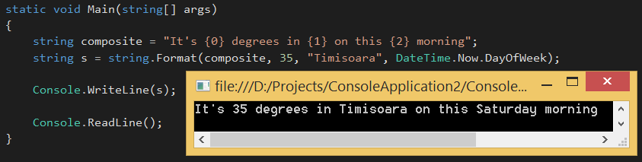
Strings – Composite formatting
The static Format method provides a convenient way to build strings that embed variables.
The embedded variables (or values) can be of any type – method Format calls ToString() on them.
Example
Each number in curly braces is called a format item – corresponds to the argument position.

Slide 16
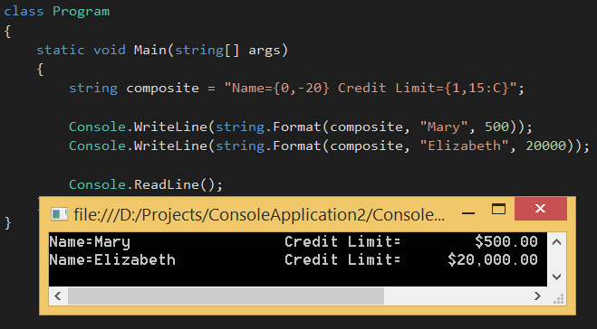
STRINGS – COMPOSITE FORMATTING
The format item is optionally followed by either:
A comma and a minimum width to apply
Negative – left aligned (spaces to the right)
Positive – right aligned (spaces to the left)
A colon and a format string

Slide 17
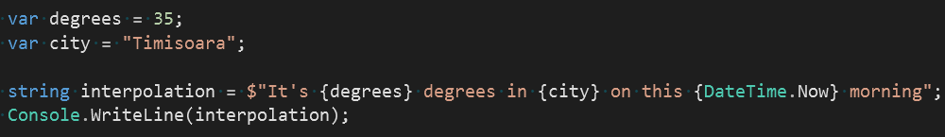
Strings – Interpolation
Is based on composite formatting but contains interpolation expression
Is more friendly for refactoring
Is transformed into Composite formatting by compiler

Slide 18
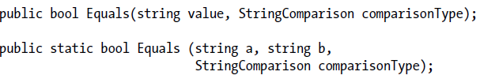
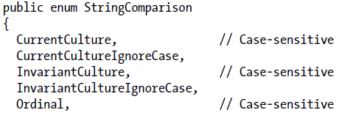

Strings – comparing
The following methods allow culture-aware or case-insensitive comparisons.
StringComparison is an enum defined as follows:

Slide 19
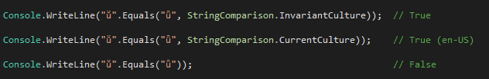
Strings – comparing
Example - The result of the third example is determined by the computer’s current language settings.
Good example can be found on MSDN

Slide 20
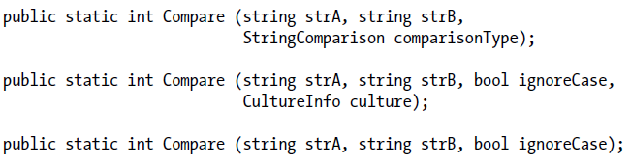
Strings – order comparison
All of the order comparison methods return a positive number, a negative number, or zero, depending on whether the first value comes after, before, or alongside the second value.
How they work
strA > strB, then 1
strA < strB, then -1
strA == strB, then 0

Slide 21
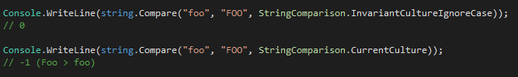
Strings – order comparison
Ignoring case
Example in Visual Studio
Plugging-in CultureInfo object
In Czech - Czech Republic culture, "ch" is a single character that is greater than "d".

Slide 22
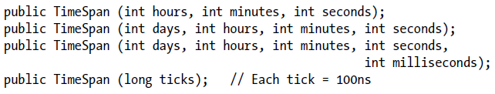
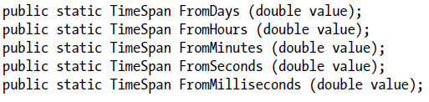
Dates and times - timespan
TimeSpan - represents an interval of time or a time of the day.
Constructors
The static From... methods are more convenient when you want to specify an interval in just a single unit, such as minutes, hours, and so on..

Slide 23
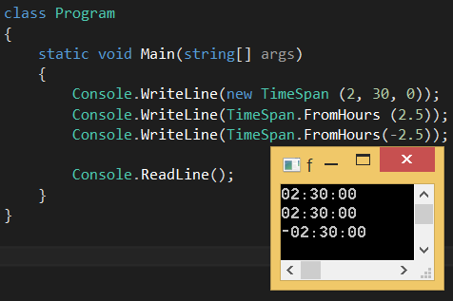
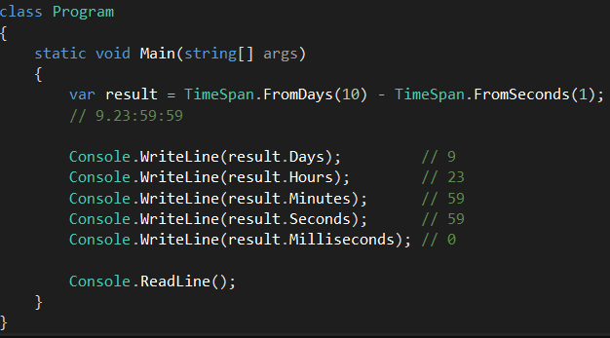
Dates and times - timespan
Examples
TimeSpan overloads the < and > operators, as well as the + and – operators.
Examples

Slide 24
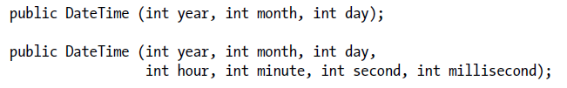
Dates and times - datetime
DateTime – Represents an instant in time, typically expressed as a date and time of day.
Constructors
If specifiy only date – time is set to midnight (0:00).
The DateTime constructors also allow you to specify a DateTimeKind – an enum with the following values: Unspecified (default value), Local, Utc
These values indicates whether the DateTime is relative to:
The local time on current computer
UTC (the equivalent of Greenwich Mean Time)
Unspecified

Slide 25
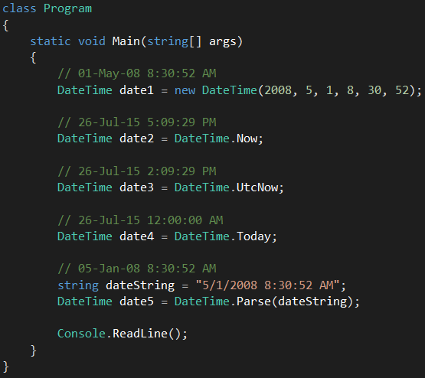
Dates and times - datetime
Examples

Slide 26
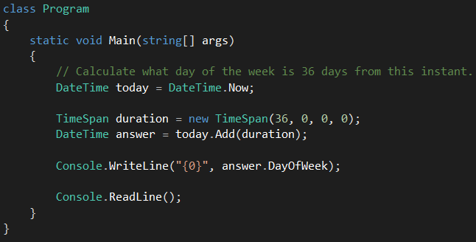
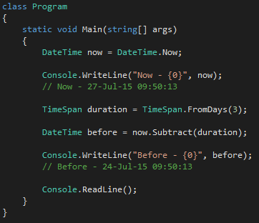
Dates and times - datetime
Add
Subtract

Slide 27

Dates and times - DateTimeOffset
Represents a point in time, typically expressed as a date and time of day, relative to Coordinated Universal Time (UTC).
Its distinguishing feature is that it also stores a UTC offset – allows more meaningful results when comparing values across different time zones.
Example – Offset from UTC – July 01 2007 03:00:00 −06:00
Example
DateTime considers the following two values different, whereas DateTimeOffset considers them equal.

Slide 28
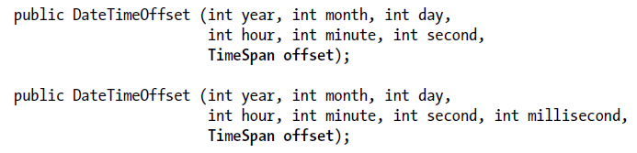
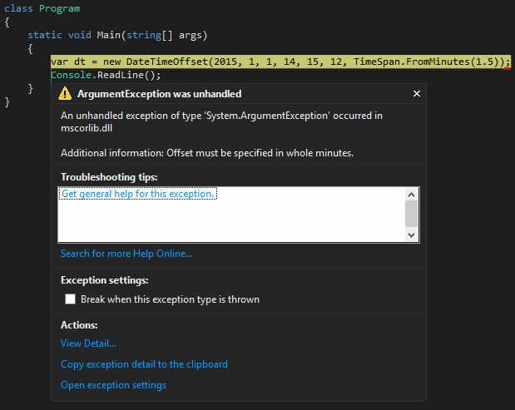
Dates and times - DateTimeOffset
Constructors
The TimeSpan parameter must amount to a whole number of minutes, or an exception is thrown.

Slide 29

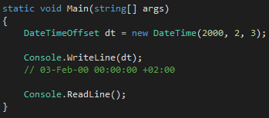
Dates and times - DateTimeOffset
More constructors
Implicit cast
If you don’t specify an offset, it’s inferred from the DateTime value using these rules:
If the DateTime has a DateTimeKind of Utc, the offset is zero.
If the DateTime has a DateTimeKind of Local or Unspecified (the default), the offset is taken from the current local time zone.

Slide 30
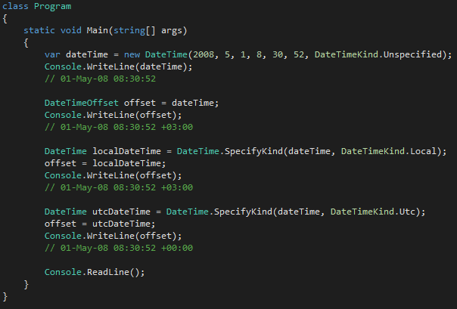
Dates and times - DateTimeOffset
Examples - implicit casting with DateTimeKind

Slide 31
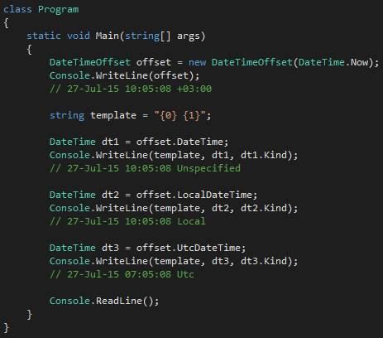
Dates and times - DateTimeOffset
Convert in the other direction
UtcDateTime property – returns DateTime in UTC time
LocalDateTime property – returns DateTime in the current local time zone
DateTime property – returns DateTime in whatever zone is was specified, with a Kind of Unspecified.

Slide 32
Time zones
TimeZone (deprecated) and TimeZoneInfo classes provide information on time zone names, UTC offsets, and daylight saving time rules.
TimeZone (deprecated) – Provides access only to the current local time zone.
TimeZoneInfo – Provides access to all the world’s time zones.

Slide 33
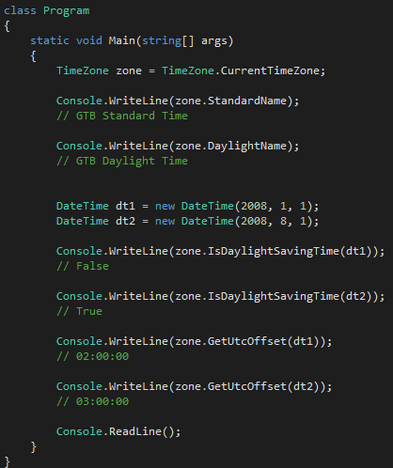
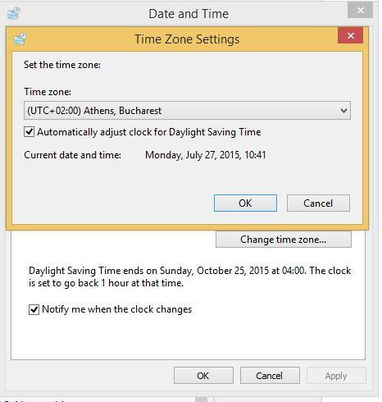
Time zones
The static TimeZone.CurrentTimeZone method returns a TimeZone object based on the current local settings.

Slide 34
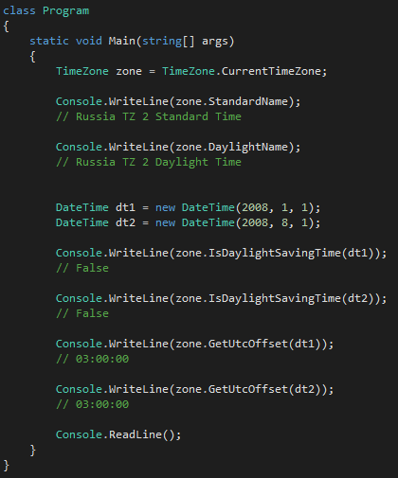
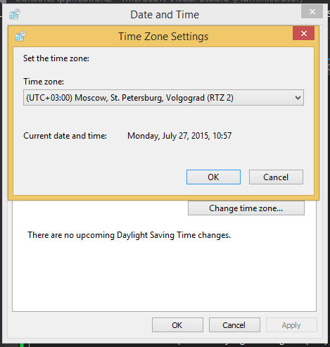
Time zones
Changing the time zone

Slide 35
Format providers
The .NET Framework defines three format providers (all of which implement IFormatProvider):
NumberFormatInfo
DateTimeFormatInfo
CultureInfo

Slide 36
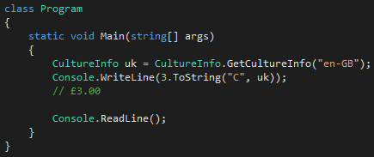
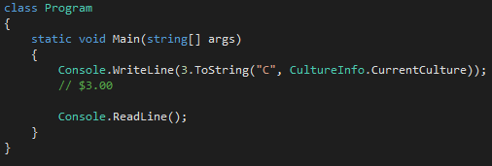
Format providers – cultureinfo
CultureInfo class provides information about a specific culture. The information includes the names for the culture, the writing system, the calendar used, the sort order of strings, and formatting for dates and numbers.
Exists in System.Globalization namespace.
Example

Slide 37
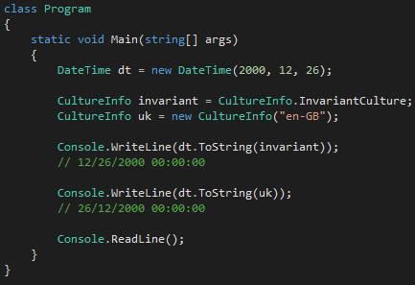
Format providers – cultureinfo
Formats a DateTime with invariant culture. Invariant culture is always the same, regardless of the computer’s settings.
Invariant culture is based on American culture, with the following differences:
The currency symbol is ☼ instead of $
Dates and times are formatted with leading zeros (though still with the month first).
Time uses the 24-hour format rather than an AM/PM designator.

Slide 38
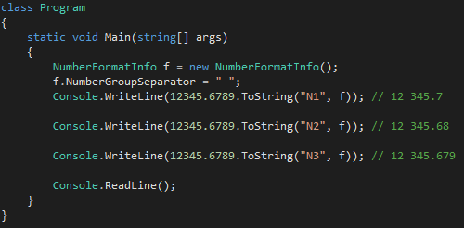
Format providers – NumberFormatInfo
Example
change the group separator from a comma to a space.
Then use it to format a number to three decimal places.
The initial settings for a NumberFormatInfo or DateTimeFormatInfo are based on the invariant culture.

Slide 39
Disposal and Garbage Collection
Some objects require explicit teardown code to release resources such as open files,
In .NET this is called disposal, and it’s supported by IDisposable interface.
The memory occupied by unused objects must also be reclaimed (at some point), this is called garbage collection.
Difference – Garbage collection is automatic, while disposing requires explicit instigation (programmer).

Slide 40
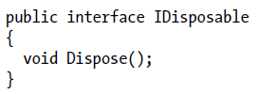
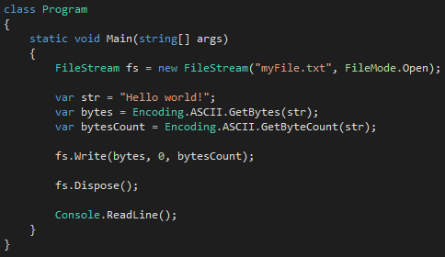
Disposal and Garbage Collection
IDisposable – special interface for types requiring a tear-down method.
Example – writing to a file

Slide 41
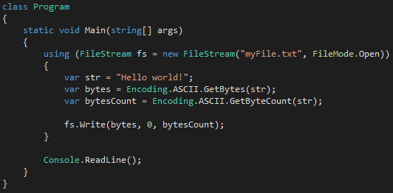
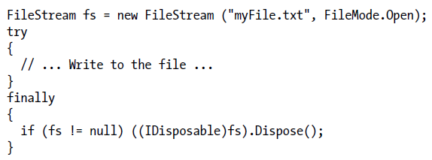
Disposal and Garbage Collection
What if Dispose() was not called (forgotten)? – File stream remains open while the application is running.
Better (safer) way – Use using
using statement provides a syntactic shortcut for calling Dispose on objects that implement IDisposable, using a try/finally block.
Compiler converts it to:

Slide 42
Disposal and Garbage Collection
Once disposed, object is beyond redemption – Can’t be reactivated – calling its methods or properties throws a ObjectDisposedException.
Calling an object’s Dispose method repeatedly causes no error.
If disposable object x contains or “wraps” or “possesses” disposable object y, x’s Dispose method automatically calls y’s Dispose method – unless instructed otherwise.

Slide 43

Disposal and Garbage Collection
At some point, the memory on heap, occupied by an object, must be freed.
Example
When Test executes, an array to hold 1,000 bytes is allocated on the memory heap.
The array is referenced by the variable array, stored on the local variable stack.
When the method exits, this local variable array pops out of scope, meaning that nothing is left to reference the array on the memory heap.
The orphaned array then becomes eligible to be reclaimed in garbage collection.

Slide 44
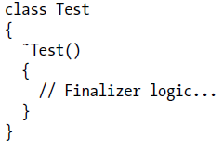
Disposal and Garbage Collection
Garbage collection does not happen immediately after an object is orphaned. It happens periodically.
Finalizer - Prior to an object being released from memory, its finalizer runs, if it has one.
A finalizer is declared like a constructor, but it is prefixed by the ˜ symbol.
Example
Finalizers cannot be declared as public or static, cannot have parameters, and cannot call the base class.

Slide 45
Disposal and Garbage Collection
Finalizers are possible because garbage collection works in distinct phases.
GC identifies the unused objects ready for deletion.
The ones without finalizers are deleted right away.
The Ones with pending (un-run) finalizers are kept alive and are put onto a special queue.
GC is done, and program continue executing.
The Finalizer Thread starts running in parallel to the program, picking objects from the special queue.
The Finalizer Thread starts executing the finalizers for those objects.
Objects with already run finalizer gets deleted in the next collection.
Therefore, finalizers can be useful, but they come with some provisos:
Slow the allocation and collection of memory (GC needs to keep track of which finalizers still need to be run)
Prolong the life of the objects (Await for the next GC run for actual deletion)
Impossible to predict in what order the finalizers (for set of objects) will be called.
Limited control over when the finalizer for an object will be called.
If one finalizer code blocks (stops), other objects can not get finalized

Slide 46
Disposal and Garbage Collection
Summary – Don’t use finalizers unless really need them.
Guidelines for implementing finalizers:
Ensure that it executes quickly.
Never block in your finalizer.
Don’t reference other finalizable objects.
Don’t throw exceptions.
An object’s finalizer can get called even if an exception is thrown during construction. For this reason, it pays not to assume that fields are correctly initialized when writing a finalizer.

Slide 47
assignment
Use encodings in writing to file stream.
Use string formatting, searching and comparing in your application.
Use timespan in your application.
Use datetime in your application.
Use datetimeoffset in your application.
Use timezone in your application.
Use cultureinfo when working with strings and numbers.
implement idisposable in your application.
Use finalizers in your application.

Slide 48
References
Albahari J, Albahari B (2012). C# 5.0 in a Nutshell

Slide 49
Revisions
Number | Author | Date | Description
1.0.0 | Rami Atieyeh | 07.12.2015 | Initial version
1.1.0 | Serghei Grajdean | 05.04.2021 | Add string interpolation

